Slide 1
Image Features (II)
Dr. Chang Shu
COMP 4900C
Winter 2008

Slide 2
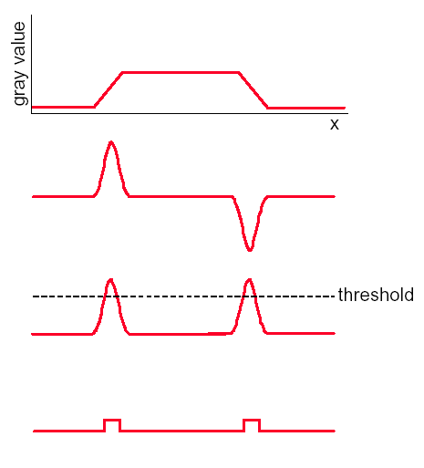



Edge Detection using Derivatives
1-D image
1st derivative
threshold
Pixels that pass the
threshold are
edge pixels

Slide 3
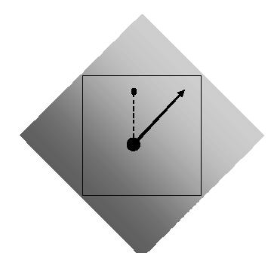
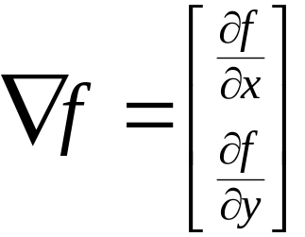
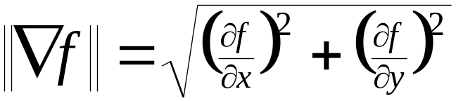
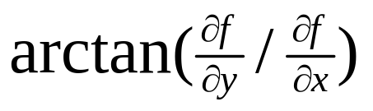
Image Gradient
gradient
magnitude
direction

Slide 4
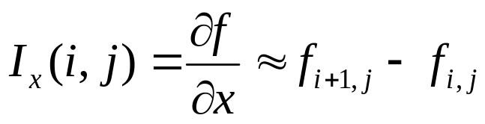

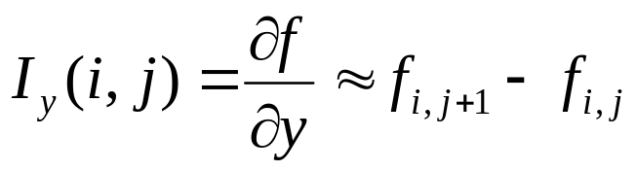
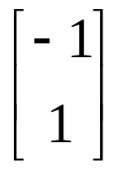
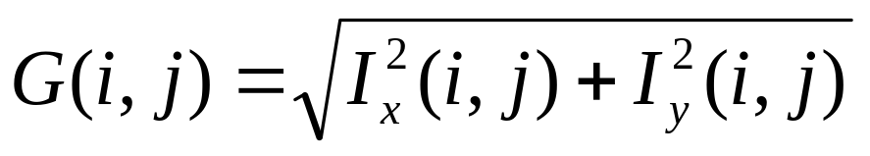
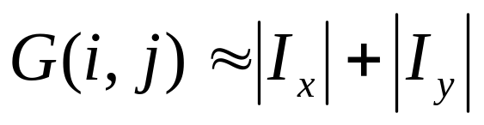
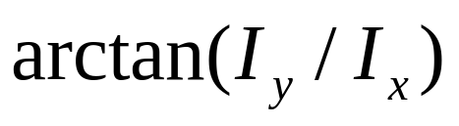
Finite Difference for Gradient
Discrete approximation:
Convolution kernels:
magnitude
aprox. magnitude
direction

Slide 5
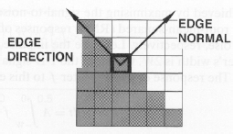
Edge Detection Using the Gradient
Properties of the gradient:
  The magnitude of gradient provides information about the strength of the edge
  The direction of gradient is always perpendicular to the direction of the edge
Main idea:
  Compute derivatives in x and y directions
  Find gradient magnitude
  Threshold gradient magnitude

Slide 6




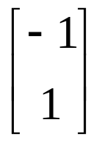

Edge Detection Algorithm
edges
Threshold
Image I

Slide 7
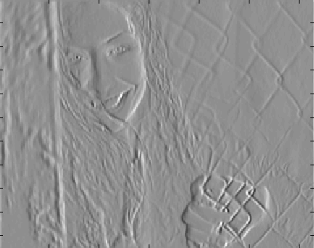


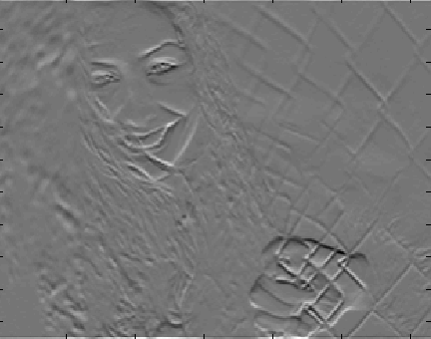
Edge Detection Example

Slide 8
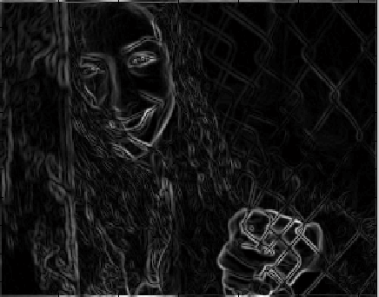
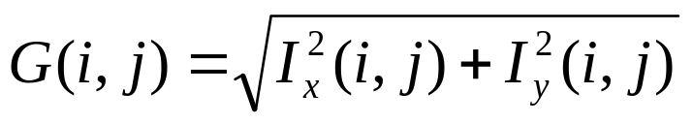
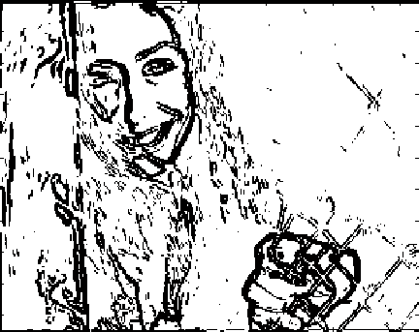

Edge Detection Example

Slide 9
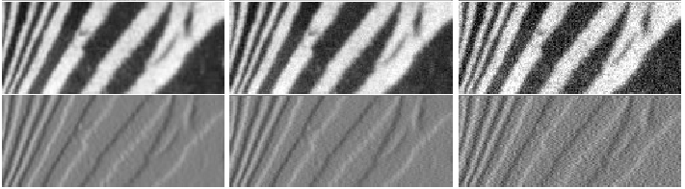
Finite differences responding to noise
Increasing noise ->
(this is zero mean additive gaussian noise)

Slide 10
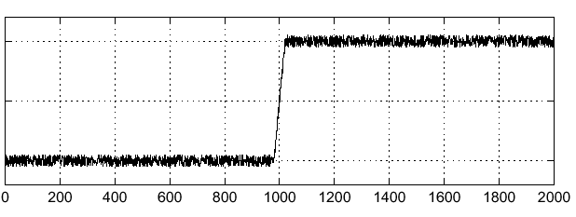

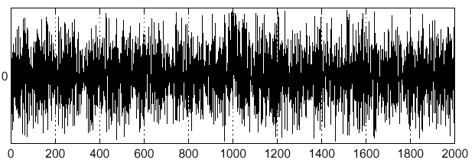
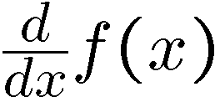
Effects of noise
Consider a single row or column of the image
  Plotting intensity as a function of position gives a signal
Where is the edge?

Slide 11
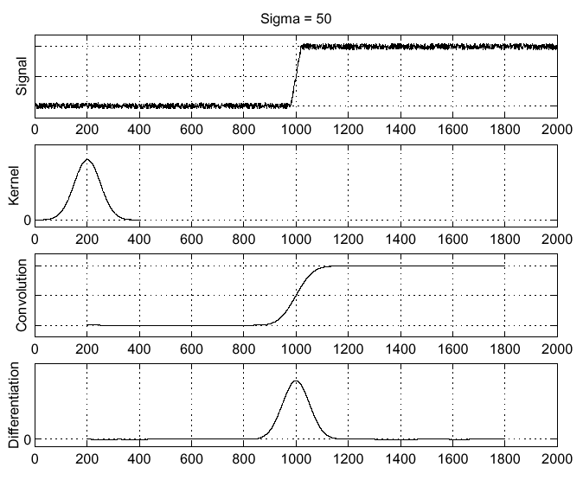



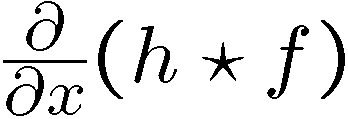
Solution: smooth first
Where is the edge?
Look for peaks in

Slide 12
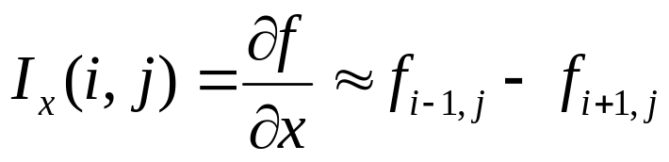
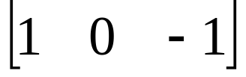
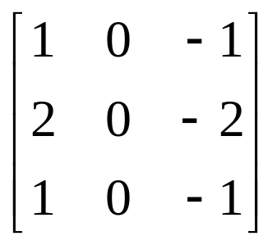
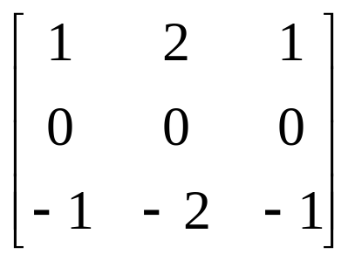

Sobel Edge Detector
Approximate derivatives with
central difference
Convolution kernel
Smoothing by adding 3 column
neighbouring differences and give
more weight to the middle one
Convolution kernel for

Slide 13
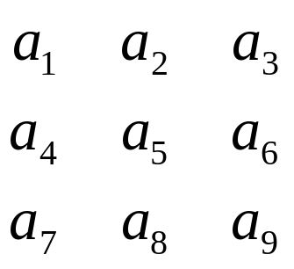



Sobel Operator Example
*
*
The approximate gradient at

Slide 14
Sobel Edge Detector
edges
Threshold
Image I

Slide 15
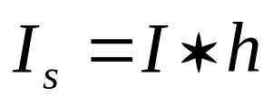



Edge Detection Summary
Input: an image I and a threshold τ.
1. Noise smoothing:
(e.g. h is a Gaussian kernel)
2. Compute two gradient images and by convolving
with gradient kernels (e.g. Sobel operator).
3. Estimate the gradient magnitude at each pixel
4. Mark as edges all pixels such that

